Slide 1

ON KNOWLEDGE GRAPHS &
PLAYER SCOUTING REPORTS
ARNAV PRASAD
UNIVERSITY OF CHICAGO – B.S. 2022
2020 SOUNDERS FC SOCCER ANALYTICS CONFERENCE
arnavprasad@uchicago.edu

Slide 2
3 truths and the elephant in the room (or stadium)...
Truth #1: Scouting has—and will always be—an essential component of soccer recruiting and player evaluation
Truth #2: Traditional analytics cannot capture certain relationships and non-physical qualities of players that scouts/experts can identify
Truth #3: Scouting ops. can be more integrated with data analytics
Question: Why is there still a disconnect between scouting ops. and analytics?
It’s time…
Iconic scene from Moneyball. But was the issue resolved?

Slide 3
A Problem & Proposal & Another Problem
So, What is a Knowledge Graph?
Problem #1: We need to use our scouts and scouting reports more intelligently. Teams need the context that scouts provide on players, but also the scalability and precision of analytics
Proposal: Apply cutting edge knowledge graph and NLP technology to bring meaning to data
Problem #2: Text data is difficult—(1) Teams need access to “digitalized” scouting reports (2) It is unstructured and thus hard to model (3) We are just scratching the surface
Knowledge graph visualizations help teams add structure to their data without sacrificing at the expense of domain-expertise or technology
The aesthetic presentation of the graphs can be fit to each group’s preference and need
KGs represent a collection of interlinked “entities” (e.g., real-world objects, people, events, situations) and their relationships
Key Characteristics – Database (can be queried), Graph (can be analyzed as network data structure), Knowledge Base (“formal semantics”—to interpret data and infer new facts)
We can create KGs automatically using preexisting NLP libraries and visualize them by using and building visual graphics
KG image provided by Ontotext

Slide 4
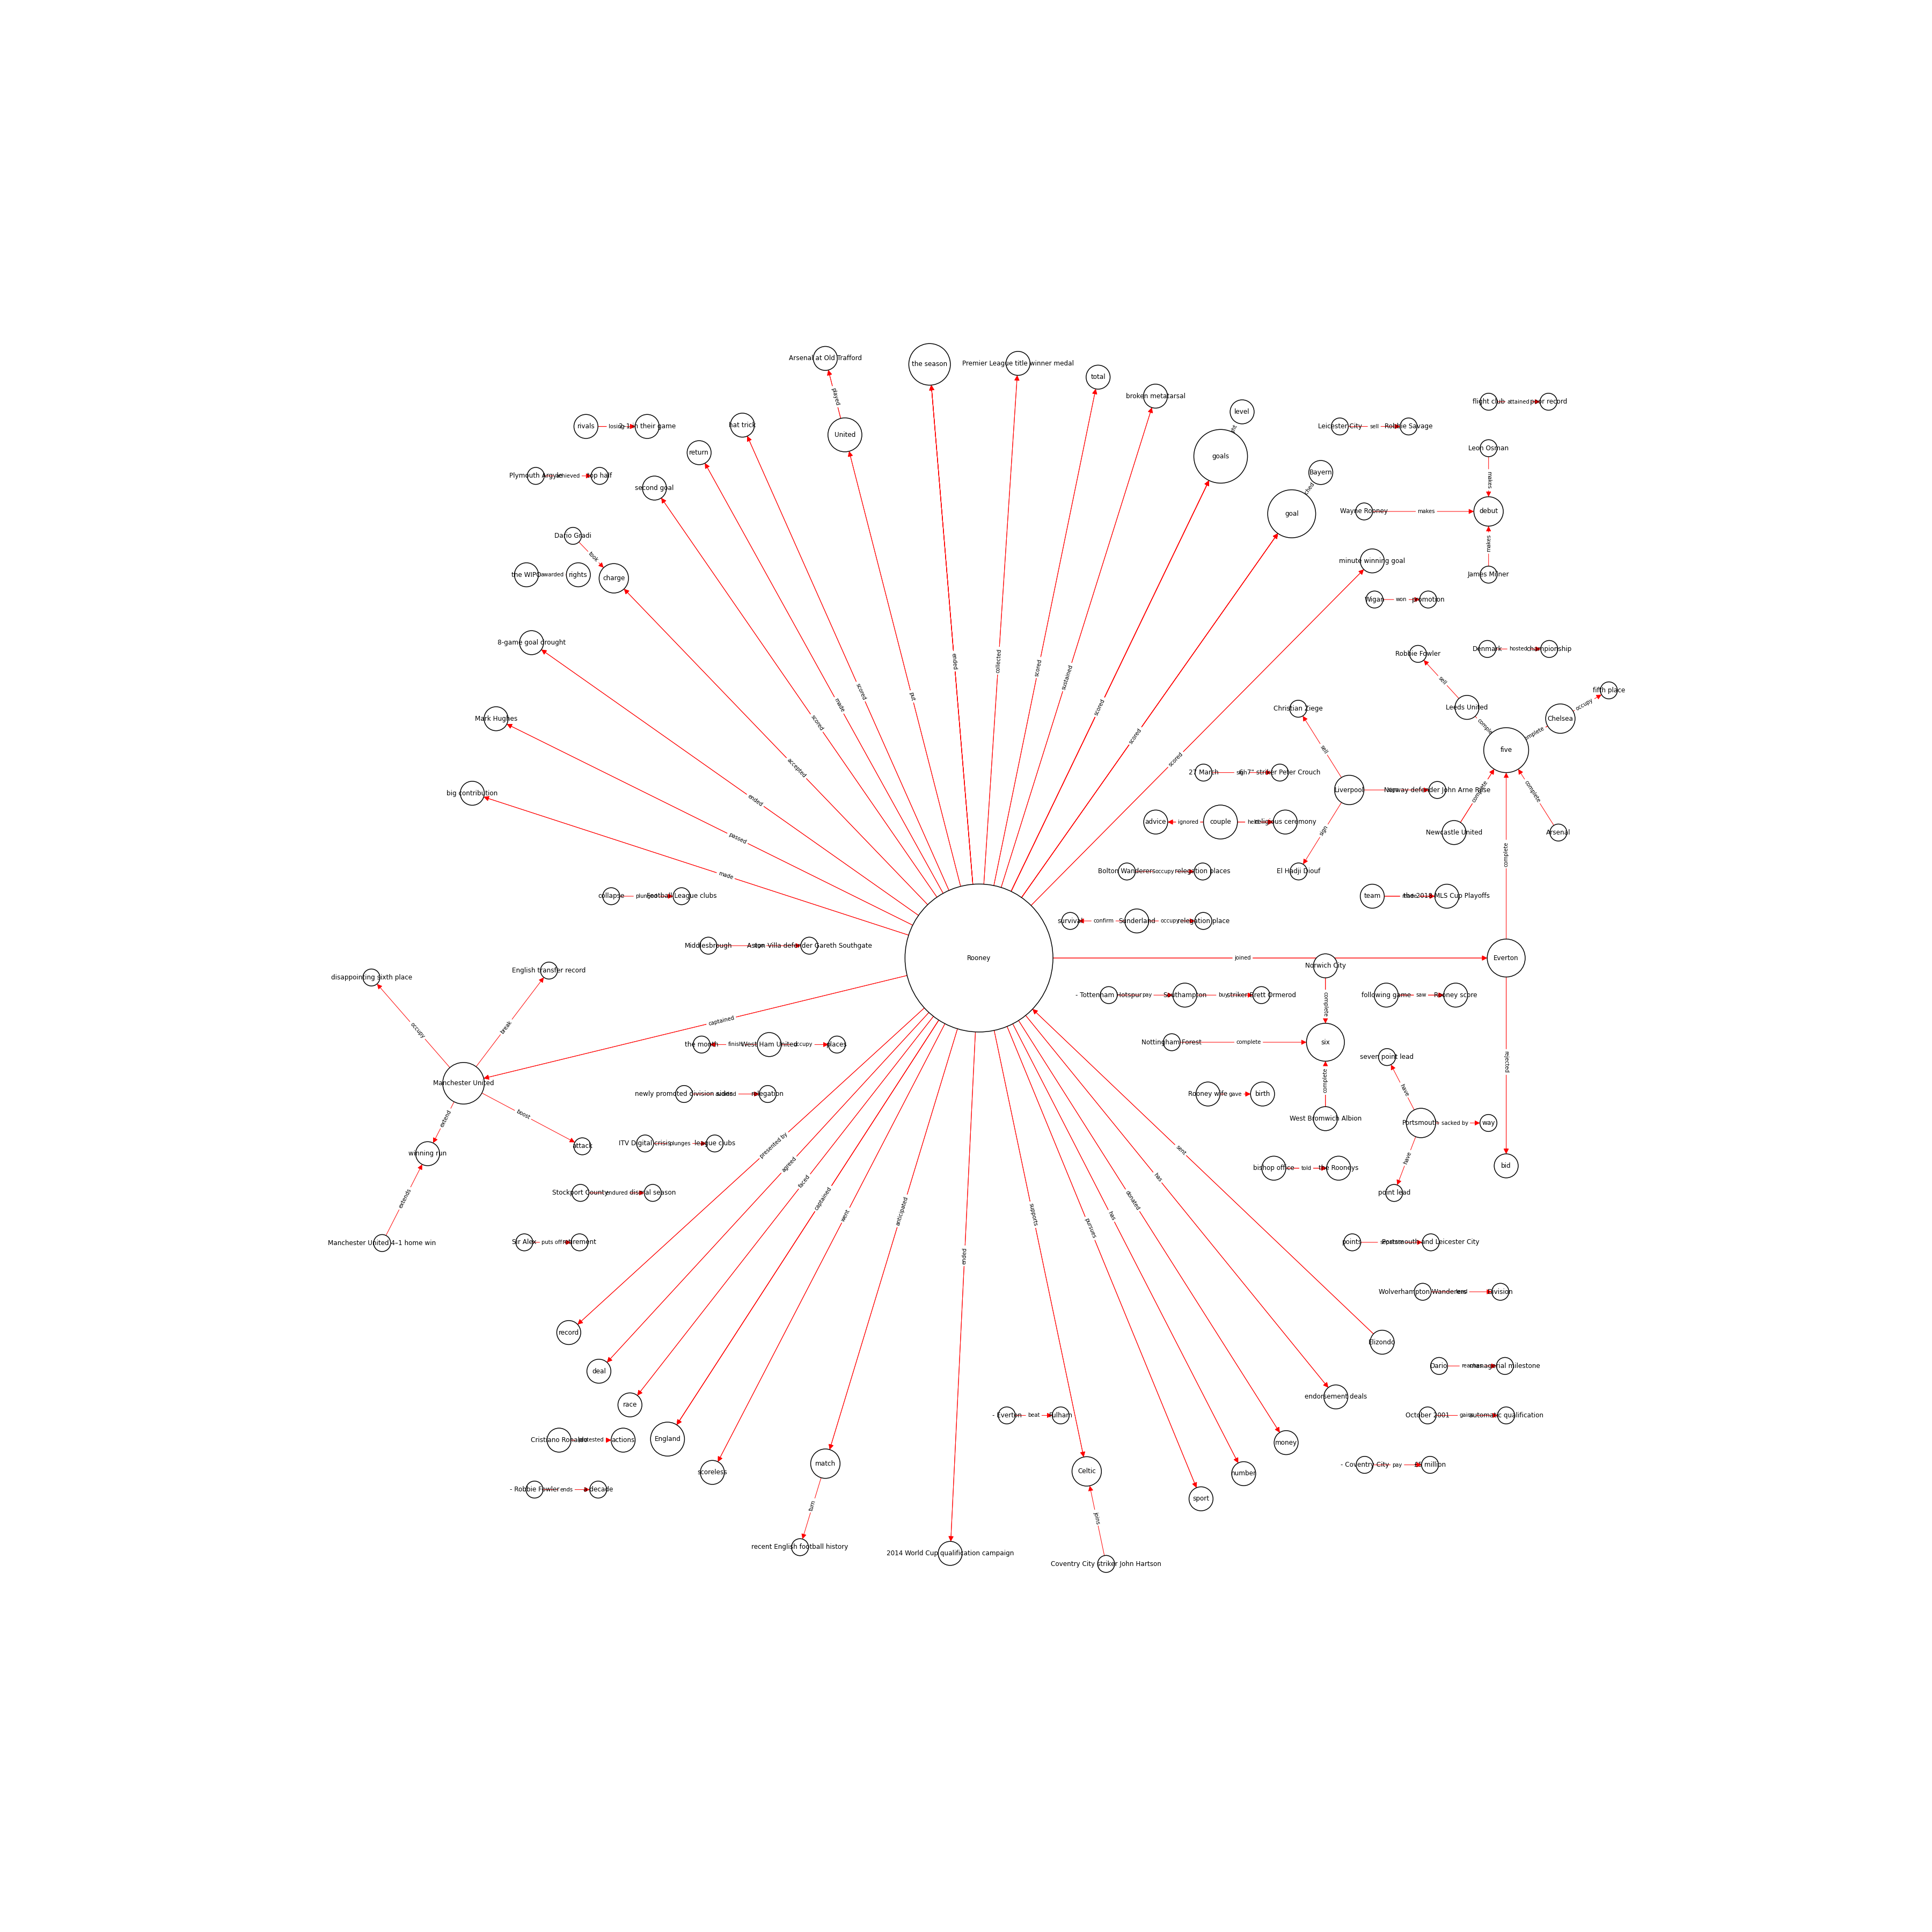
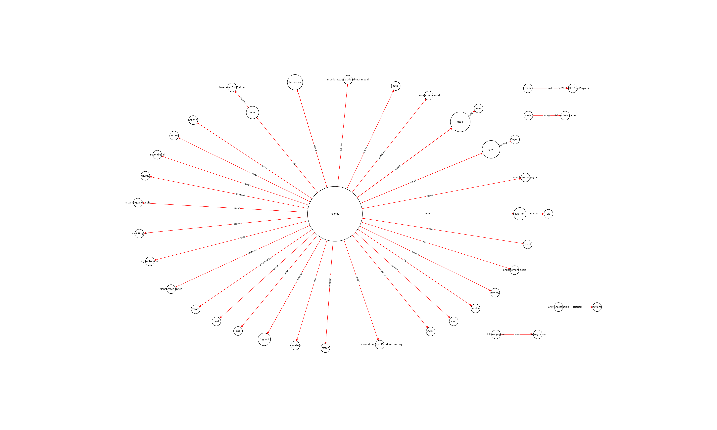
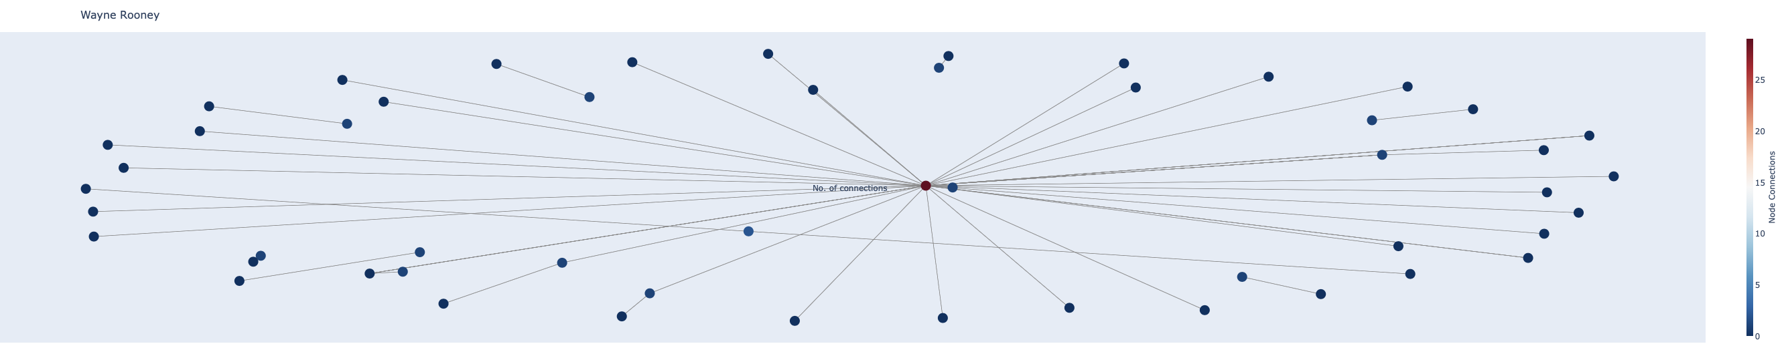
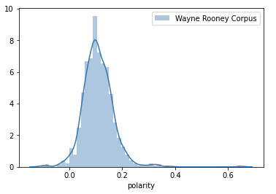
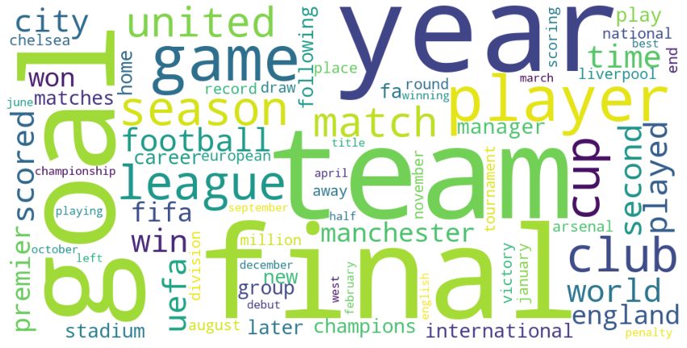
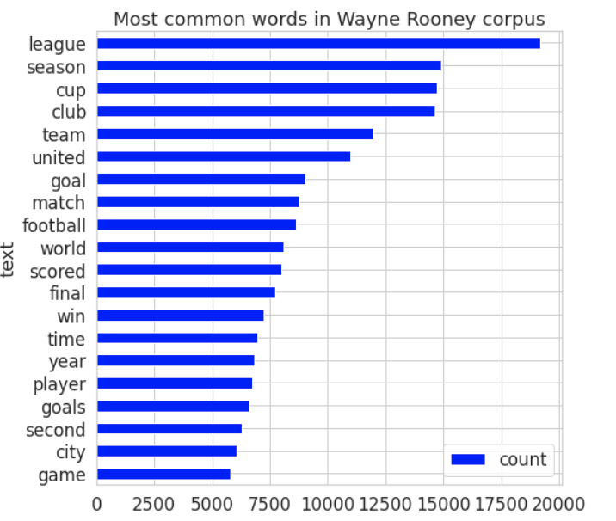
Approach & Results
Example for Wayne Rooney
Data: Publicly-available Wikipedia articles that contained a certain player’s name were scraped (in lieu of scouting reports)
NLP pipeline (in Python) →
Collect/generate text data
Automatic entity-pair extraction & other text preprocessing
(3) Visualization & knowledge graph creation
Approach: Text analytics visualizations, topic visualizations, interactive player knowledge graph, ”queried” graph to specific entity → complete, visual scouting profile
Results: What scouting-specific relationships can we capture? Player’s club, transfers, coaches, defining game moments, opponents, injuries, awards…
KG for 5 pages
KG for 1 page (see slide 5)
Interactive web module
Distribution of word polarity
Most common words in entire corpus of ~800 documents
Word-cloud for the corpus
Note: Non-soccer topics were filtered out in KGs (Wikipedia has personal information that scouting reports do not!)

Slide 5
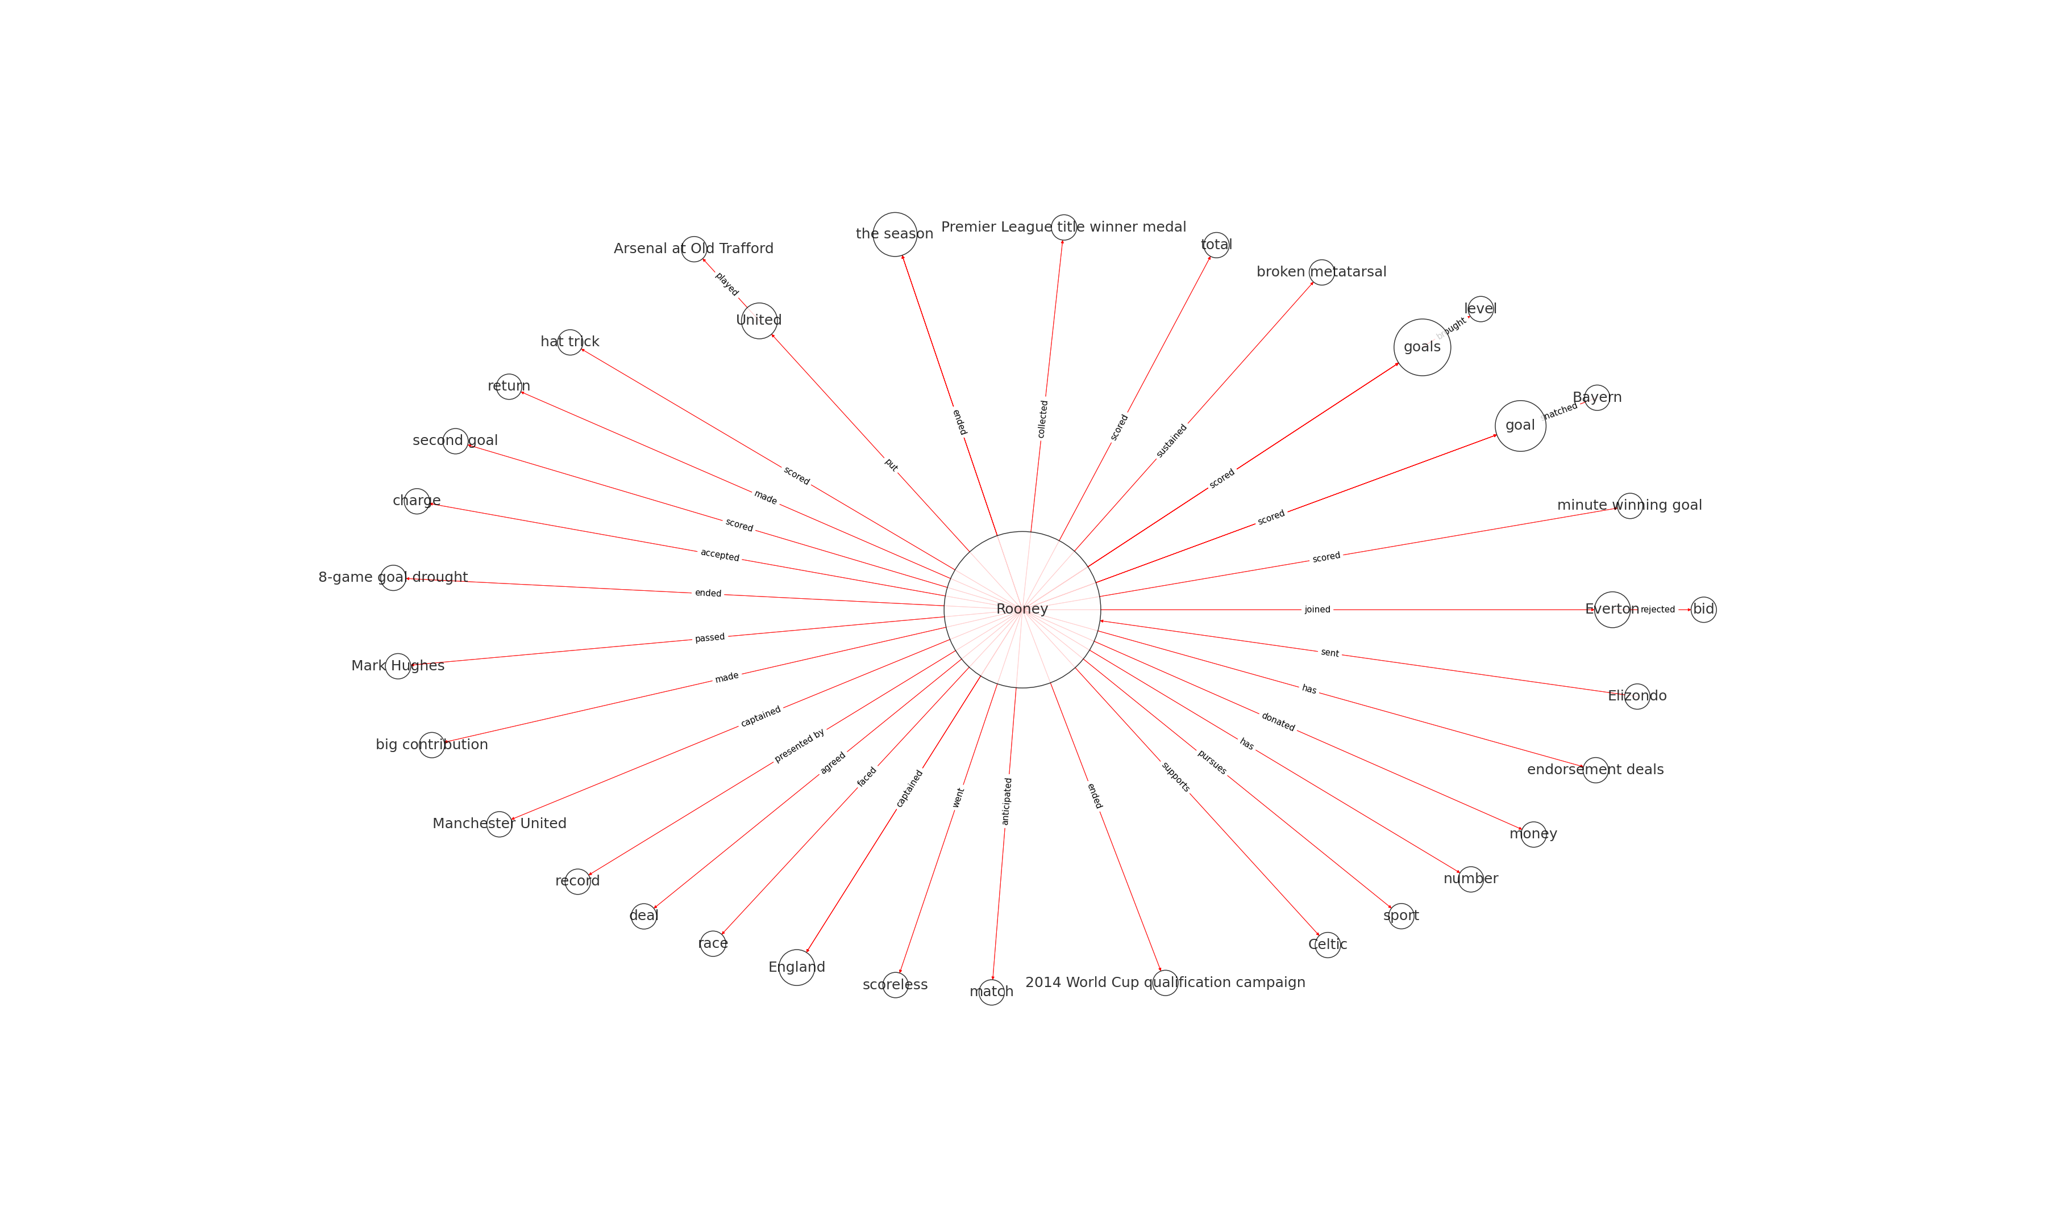
To Infinity & Beyond…
The potential for knowledge graphs and NLP in soccer and player scouting is limitless. We can:
Auto-generate visual profiles for scouts based on language in their reports
Visualize similar players based on their knowledge graphs (not just on entities themselves, but on the underlying relationships!)
Build knowledge graph visualizations to capture contextual information in-real time during games
Knowledge graph visualizations offer valuable contextual information on prospects and players for coaches, scouts, data analysts, and other key decision-makers
We need to close the gap between scouting and performance analytics!
Images & code are available upon request.
Thank You!
Questions, Comments, & Other Inquiries: arnavprasad@uchicago.edu

